Slide 1
Software Engineering
Sobia Iftikhar
Sobia.Iftikhar@nu.edu.pk
Week 05

Slide 2
Content
Requirement Engineering
Estimation Techniques
Wide band Delphi
Work Breakdown Structure

Slide 3
Class 13 10-March-2021

Slide 4
Requirements Specification

Slide 5
Requirements specification
The process of writing down the user and system requirements in a requirements document.
User requirements must be understandable by end-users and customers who do not have a technical background.
System requirements are more detailed requirements and may include more technical information.
The requirements may be part of a contract for the system development
It is therefore important that these are as complete as possible.

Slide 6
Ways of writing a system requirements specification
Notation | Description
Natural language | The requirements are written using numbered sentences in natural language. Each sentence should express one requirement.
Structured natural language | The requirements are written in natural language on a standard form or template. Each field provides information about an aspect of the requirement.
Design description languages | This approach uses a language like a programming language, but with more abstract features to specify the requirements by defining an operational model of the system. This approach is now rarely used although it can be useful for interface specifications.
Graphical notations | Graphical models, supplemented by text annotations, are used to define the functional requirements for the system; UML use case and sequence diagrams are commonly used.
Mathematical specifications | These notations are based on mathematical concepts such as finite-state machines or sets. Although these unambiguous specifications can reduce the ambiguity in a requirements document, most customers don’t understand a formal specification. They cannot check that it represents what they want and are reluctant to accept it as a system contract

Slide 7
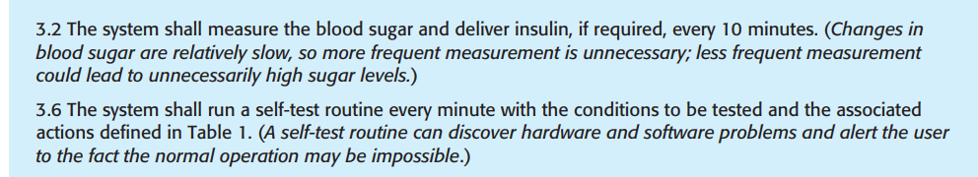
Natural language specification
should write the requirement in one or two sentences of natural language.
using “shall.” for essential requirements.
Desirable requirements are not essential and are written using “should.”
Use text highlighting (bold, italic, or color) to pick out key parts of the requirement.
Do not assume that readers understand technical, software engineering language. It is easy for words such as “architecture” and “module”

Slide 8
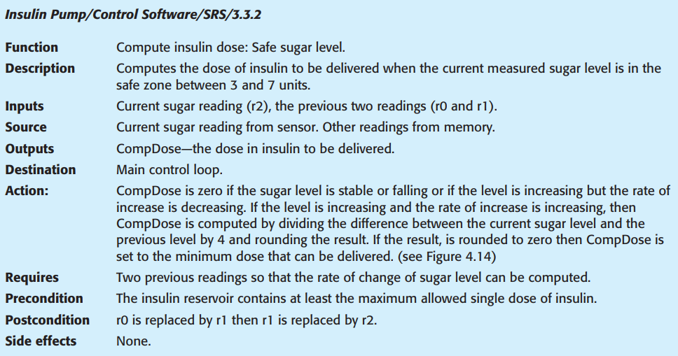
Structured specifications
1. A description of the function or entity being specified.
2. A description of its inputs and the origin of these inputs.
3. A description of its outputs and the destination of these outputs.
4. Information about the information needed for the computation or other entities
in the system that are required (the “requires” part).
5. A description of the action to be taken.
6. If a functional approach is used, a precondition setting out what must be true before the function is called, and a Postcondition specifying what is true after the function is called.
7. A description of the side effects (if any) of the operation

Slide 9
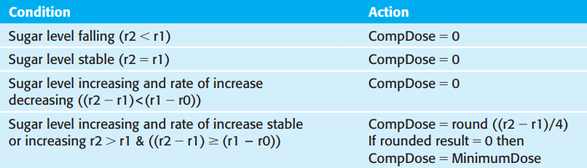
Mathematical Notations
computations of the insulin requirement

Slide 10
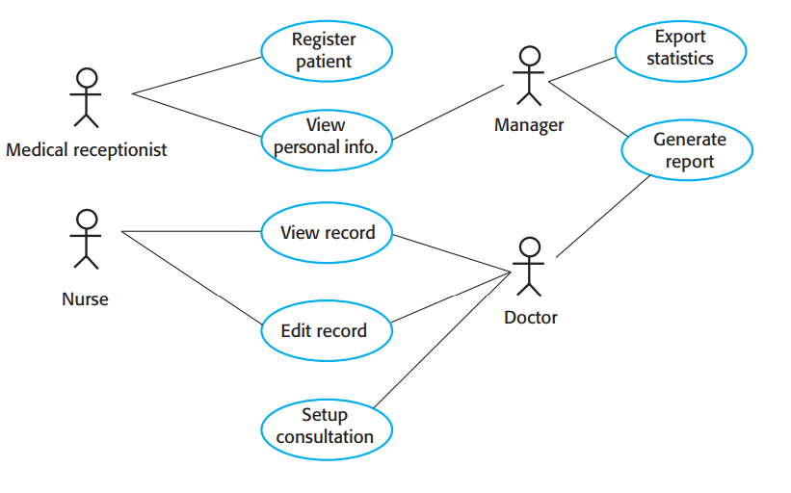
Graphically Language

Slide 11
System Requirements Documentation

Slide 12
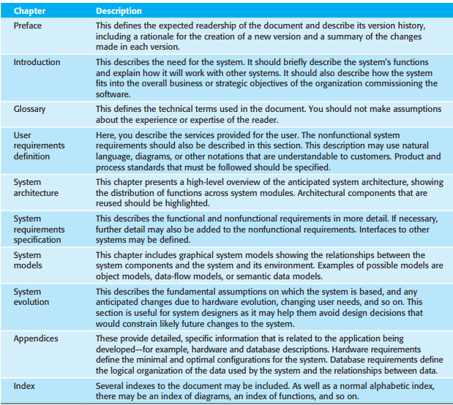
Users of a requirements document

Slide 13
Requirements validation

Slide 14
Requirements validation
Requirements validation is the process of checking that requirements define the system that the customer really wants.
Requirements error costs are high so validation is very important
Fixing a requirements error after delivery may cost up to 100 times the cost of fixing an implementation error.

Slide 15
Requirements checking
Validity. Does the system provide the functions which best support the customer’s needs?
Consistency. Are there any requirements conflicts?
Completeness. Are all functions required by the customer included?
Realism. Can the requirements be implemented given available budget and technology
Verifiability. Can the requirements be checked?

Slide 16
Requirements validation techniques
Requirements reviews
Systematic manual analysis of the requirements.
Prototyping
Using an executable model of the system to check requirements. Covered in Chapter 2.
Test-case generation
Developing tests for requirements to check testability.

Slide 17
Requirements change

Slide 18
Changing requirements
The business and technical environment of the system always changes after installation.
New hardware may be introduced, it may be necessary to interface the system with other systems, business priorities may change (with consequent changes in the system support required), and new legislation and regulations may be introduced that the system must necessarily abide by.
The people who pay for a system and the users of that system are rarely the same people.
System customers impose requirements because of organizational and budgetary constraints. These may conflict with end-user requirements and, after delivery, new features may have to be added for user support if the system is to meet its goals.

Slide 19
Requirements evolution

Slide 20
Requirements change management
Deciding if a requirements change should be accepted
Problem analysis and change specification
During this stage, the problem or the change proposal is analyzed to check that it is valid. This analysis is fed back to the change requestor who may respond with a more specific requirements change proposal, or decide to withdraw the request.
Change analysis and costing
The effect of the proposed change is assessed using traceability information and general knowledge of the system requirements. Once this analysis is completed, a decision is made whether or not to proceed with the requirements change.
Change implementation
The requirements document and, where necessary, the system design and implementation, are modified. Ideally, the document should be organized so that changes can be easily implemented.

Slide 21
Requirements change management

Slide 22
Examples of open-ended questions:
Where would you like your business to grow from here?
What would success look like to you?
What campaigns are out there right now that caught your eye, and for what reasons?
What are a couple day-to-day practices of yours that people can implement for greater success/fulfillment in their own lives?
Can you give me a few dates for a follow-up call?
Examples of closed-ended questions
Are you satisfied with your current sales numbers?
What is your #1 goal?
Did you like your competitor’s latest campaign/commercial?
Where can someone go to learn more about what you do?

Slide 23
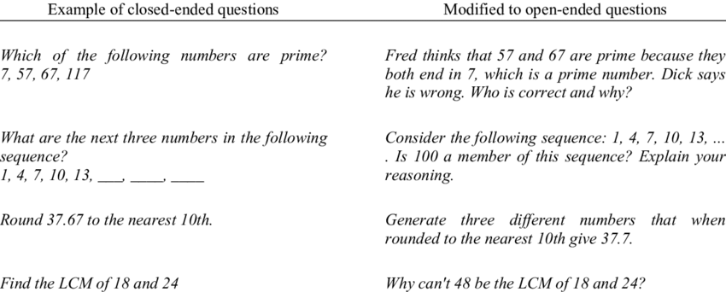
Which on open and close side

Slide 24
Class 14 11-March-2021

Slide 25
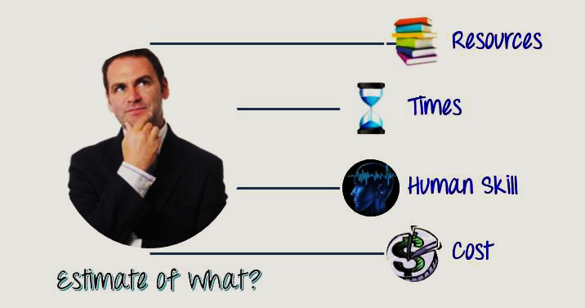
Software Project Management
What is estimation?
The project manager must set expectations about the time required to complete the software among the stakeholders, the team, and the organization’s management.
If those expectations are not realistic from the beginning of the project, the stakeholders will not trust the team or the project manager.

Slide 26
Estimation Techniques
Work Breakdown Structure (WBS)
Wideband Delphi

Slide 27
Wideband Delphi
Wideband Delphi is a process that a team can use to generate an estimate
The project manager chooses an estimation team, and gains consensus among that team on the results
Wideband Delphi is a repeatable estimation process because it consists of a straightforward set of steps that can be performed the same way each time

Slide 28
Wide Band Delphi
For each task, each estimator provide the:
Optimistic effort: the least cost and least time
Pessimistic effort: the most cost and the time
Expected effort: the realistic forecast
Calculate the average of these estimates form each estimators
E = 0+P+4B/6

Slide 29
The Wideband Delphi Process
Planning
Individual Estimation
Estimation Meeting
Kickoff Meeting
Assemble Tasks & Review Results

Slide 30
The Wideband Delphi Process
Step 1: Choose the team.
The project manager selects the estimation team and a moderator. the team should consist of 3 to 7 project team members.
The moderator should be familiar with the Delphi process, but should not have a stake in the outcome of the session if possible.
If possible, the project manager should not be the moderator because he should ideally be part of the estimation team.

Slide 31
Step 2: Kickoff Meeting
The project manager must make sure that each team member understands the Delphi process, has read the vision and scope document and any other documentation, and is familiar with the project background and needs.
The team brainstorms and writes down assumptions.
The team generates a WBS with 10-20 tasks.
The team agrees on a unit of estimation.

Slide 32
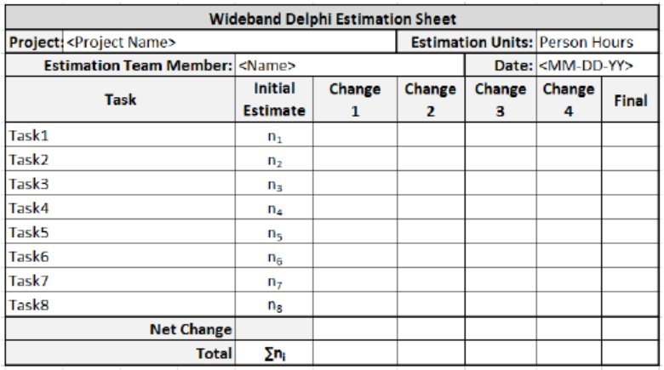
Step 3: Individual Preparation
Each team member independently generates a set of preparation results.
For each task, the team member writes down an estimate for the effort required to complete the task, and any additional assumptions he needed to make in order to generate the estimate.

Slide 33
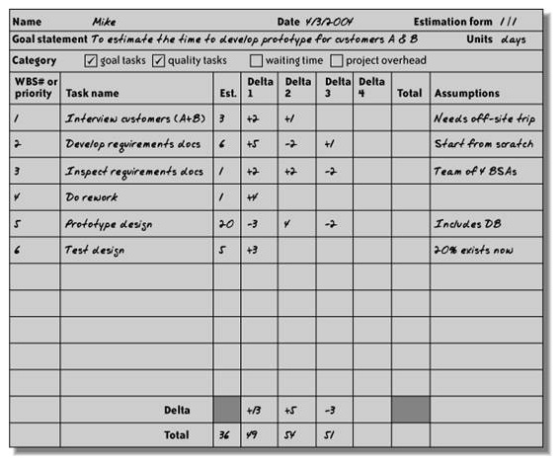
Estimation form for every person

Slide 34
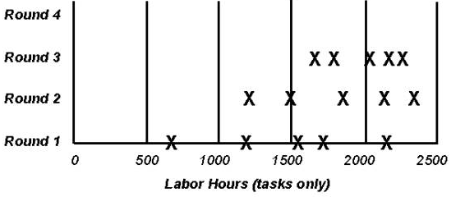
Step 4: Estimation Session
The moderator calls the Estimation team for the Estimation meeting. If any of the Estimation team members respond saying that the estimates are not ready, the moderator gives more time and resends the Meeting Invite.
The moderator begins the estimation meeting by collecting and charting the participants' individual estimates. Each participant's total project estimate is shown as an X on the "Round 1" line. The initial estimates probably will cover a frighteningly large range.

Slide 35
Step 5: Assemble Tasks
The project manager works with the team to collect the estimates from the team members at the end of the meeting and compiles the final task list, estimates and assumptions.
Step 6: Review Results
The project manager reviews the final task list with the estimation team.

Slide 36
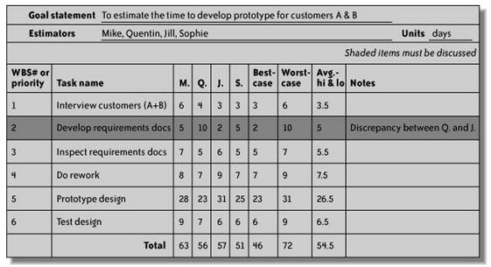
Summarized result of estimation

Slide 37
What is WBS?
Breaking work into smaller tasks is a common productivity technique used to make the work more manageable and approachable.
For projects, the Work Breakdown Structure (WBS) is the tool that utilizes this technique and is one of the most important project management documents. It singlehandedly integrates scope, cost and schedule baselines ensuring that project plans are in alignment.
37

Slide 38
The Work Breakdown Structure
Used as a basis for a number of in particular to produce the subsidiary plans of the Project Management Plan.
The WBS is a deliverable-oriented hierarchy of decomposed project components.
The WBS is a representation of the detailed project scope statement that specifies the work to be accomplished by the project.
The elements comprising the WBS assist the stakeholders in viewing the end product of the project.
The work at the lowest-level WBS component is estimated, scheduled, and tracked.
WBS

Slide 39
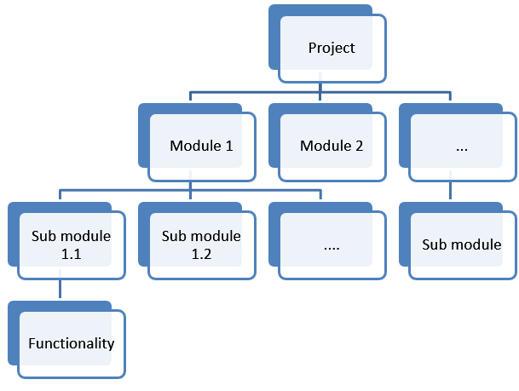

Slide 40
When should we develop WBS?
Once the project Scope is agreed (finalized) then before starting the project we need to plan various components (activities) of software development project.

Slide 41
WBS Guidelines
Accurate and readable project organization.
Accurate assignment of responsibilities to the project team.
Indicates the project milestones and control points.
Helps to estimate the cost, time, and risk.
Illustrate the project scope, so the stakeholders can have a better understanding of the same.
41

Slide 42
Guidelines - continued
Include three types of project work
Product
Specifically assigned to a physical product as a unique deliverable
This subset is sometimes referred to as the product breakdown structure
Integration
When products are brought together as a unit
Can be at any level
Support
Level of Effort, Administration, Expenses, Improvement Practices, Contractor Management

Slide 43
Steps to build a WBS
Begin with the Charter, focusing on Objectives and Deliverables
Break the main product(s) down into sub-products
Set the structure to match how you’ll manage the project
Lowest level not too detailed, not too large
Is there a need for Integration?
Identify support activities
Check for completeness - is all the effort included?
Develop a coding structure if needed
Assign work package managers
43

Slide 44
WBS Formats
2 Formats
Outline (Indented Format)
Graphical Tree (Organizational Chart)

Slide 45
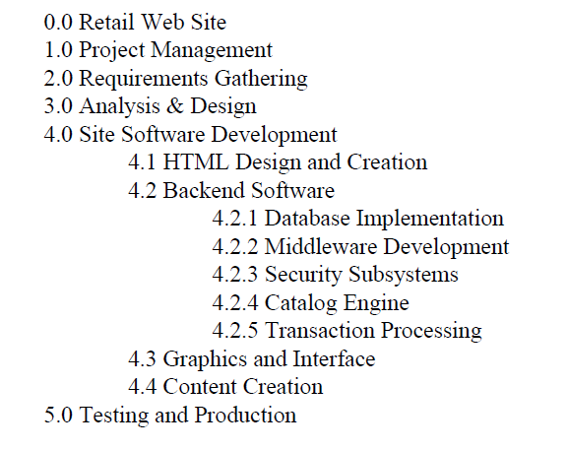
Displaying the WBS Example of outlined WBS.
45

Slide 46
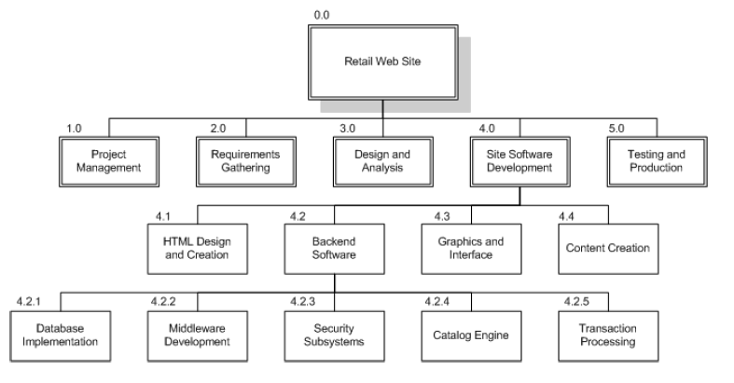
Displaying the WBS Example of Chart WBS.
46

Slide 47
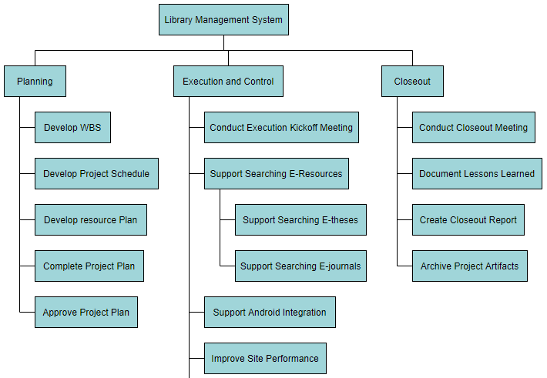
https://online.visual-paradigm.com/diagrams/features/work-breakdown-structure-software/

Slide 48
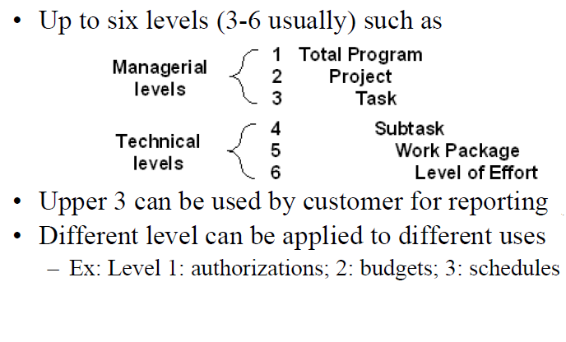
A Full WBS Structure
48

Slide 49
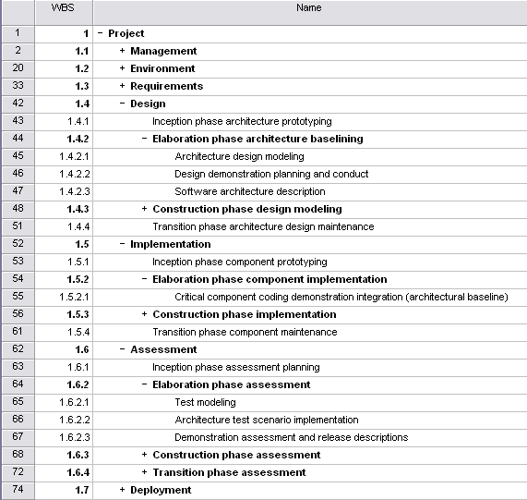
WBS Template
Component groups with a ‘+’ in front of them are ‘rolled up’ – subcomponents are hidden to reduce clutter
49

Slide 50
Example WBS
Redecorate Room
Prepare materials
Buy paint
Buy a ladder
Buy brushes/rollers
Buy wallpaper remover
Prepare room
Remove old wallpaper
Remove detachable decorations
Cover floor with old newspapers
Cover electrical outlets/switches with tape
Cover furniture with sheets
Paint the room
Clean up the room
Dispose or store left over paint
Clean brushes/rollers
Dispose of old newspapers
Remove covers
WBS

